Slide 1
Final Presentations (Week 14)
You will give a demonstration of your visualization in action for your classmates during the discussion section. Like the mid-term presentations, you will have 15 minutes.
This demonstration is your chance to show your fellow students how far your design has come since the mid-term milestone. Tell us what you changed and why.
You must include details and conclusions from at least one round of usability testing (with at least three different subjects).Tell how your design changed (or will change) in response to your findings.
Also address your choice of tools for building the final interactive visualization
All team members must participate in the presentation.
Grading Rubric for Final Project (not just presentation)
Your instructor will consider the final presentations, the web site, and any additional information you provide in the final paper in determining a single grade for the final project.
12 points - Is the final product of appropriate form?
12 points - Does it successfully solve a problem or inform the user?
12 points - Is the explanatory text clear?
12 points - Did you show substantial iteration?
10 points - Can the visualization be understood without too much effort?
10 points - Is it aesthetically pleasing?
10 points - Did you include results of usability testing?
8 points - Did you present data in a novel way?
8 points - Did you explain your choice of tools?
6 points - Did everyone in your group participate?

Slide 2
Outline for the final presentation
Project Objective and Target Users (2 mins)
what our project is about
target users
Our progress as of mid-term
Technology stack (and rationale) used to create end product (2 mins)
Balsamiq for mockups
Highcharts
Flask
Pythonanywhere to host
Usability testing and prioritized changes (5 mins)
Users we talked to
What we learned (details) and corresponding changes (conclusions) we made (5 mins)
Show old version (from mid-term) with callouts showing what we changed)
Demo of our visualization (6 mins)
3 mins for each visualization

Slide 3
Insight@ADP Visualizing ADP’s National Employment Report
Saad Padela, Roiana Reid, Amin Venjara
August 8, 2016

Slide 4




Roadmap for our presentation
Project Objective and
Target Users
AV
Technology Choices
SP
Usability Testing and Learnings
AV/ RR
Updated Visualization
SP/ RR

Slide 5

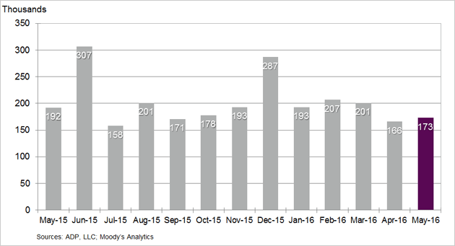
A quick reminder about our project Current state of the NER and our objective
Objective
Current State of the
National Employment Report
Project Objective
The National Employment Report (NER) is an estimate of total US employment produced monthly by ADP, a payroll service provider
1 in every 6 working Americans is paid via ADP (24 million workers)
Explore new and interactive ways for users to engage with the NER data and easily consume the economic insights that emerge from them via 2 visualizations:
Jobs Explorer
Allow users to explore the different dimensions of the National Employment Report via an intuitive and flexible visualization
Change in Nonfarm Private Employment
Bureau of Labor Statistics (BLS) Comparison
Enable users to understand the predictive power of the National Employment Report by comparing it against historical Bureau of Labor Statistics data

Slide 6
Business journalists and financial professionals are our target audience
Objective
Priority | Segment | Likelihood to visit | Need from Data | Visualization Need
Target Users | Business Journalists | High (need to deliver timely business insight to a general audience) | Want to report the most recent numbers Statistics to support a current story Background to inform a potential story | Communicative Make it simple to understand trends Give me a visual to support my story
 | Economists / Financial professionals | Medium / High (likely to get data from Bloomberg or aggregating data source) | Most recent data to inform economic models Investigate predictors to help forecast market movements | Exploratory Give me the raw data, so I can play with it myself Help me see trends to inform my own hypotheses
Potential future focus | Students | Medium (awareness of ADP report may be low) | Input to a exploratory model or a paper related to labor / economic concerns | Exploratory Make it easy for me to tailor data to my project
 | Policy makers | Medium (tend to favor official government data) | Context and supporting data for proposed legislation | Communicative Make it easy for me to see trends relative to my constituents
 | Small businesses | Low (busy running their businesses) | Put their own experience in context of the broader economy | Communicative Help me understand how I relate to businesses like me

Slide 7
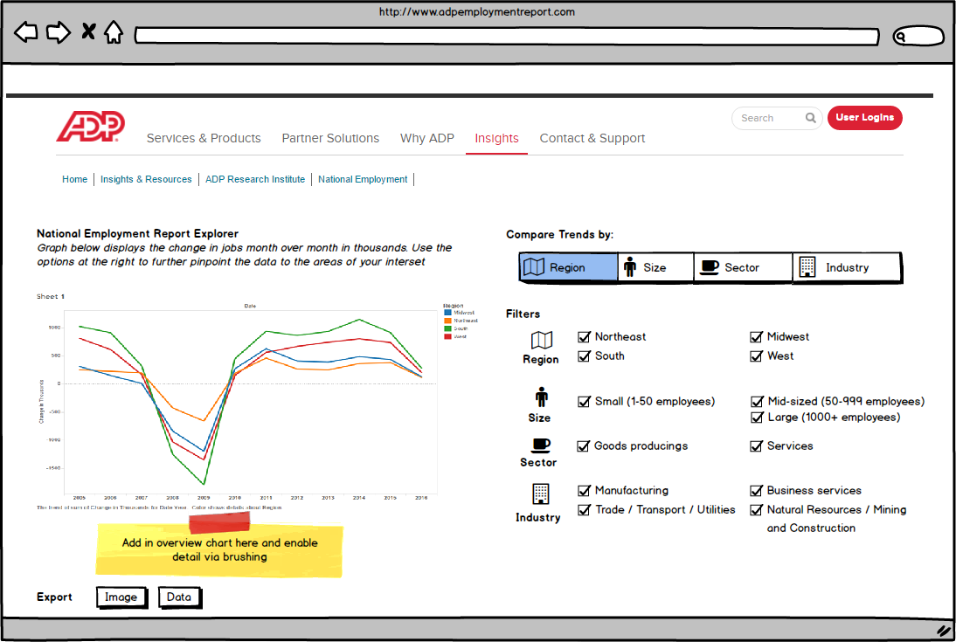
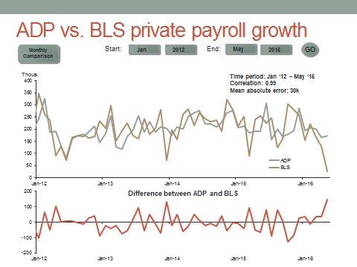
Where we left off as of the mid-term Design mockups
Objective
Jobs Explorer
BLS Comparison

Slide 8

A few technology choices were fundamental to building our final visualization
Technology
SP
Function |  | Technology |  | Rationale
Visualization |  | Highcharts / Highstock |  | Add commentary Add commentary Sub-bullet format
Data Manipulation |  | Pandas + Flask |  | Add commentary Add commentary Sub-bullet format
Hosting |  | Pythonanywhere |  | Add commentary Add commentary Sub-bullet format

Slide 9

Who we talked to
UX Testing
AV / RR

Slide 10
Testing uncovered a number of potential changes to improve the user experience
UX Testing
AV / RR
Tool | Observation / Learning |  | Changes
Jobs Explorer | Lesson #1 |  | Add commentary Add Commentary
 | Lesson #2 |  | Add commentary Add Commentary
 | Lesson #2 |  | Add commentary Add Commentary
BLS Comparison | Lesson #1 |  | Add commentary Add Commentary
 | Lesson #2 |  | Add commentary Add Commentary
 | Lesson #3 |  | Add commentary Add Commentary

Slide 11
We used MoSCoW method to prioritize our changes Parallel development tracks for Jobs Exploer and BLS Comparison
UX Testing
AV / RR
Priority |  | Jobs Explorer |  | BLS Comparison
Must Have |  | Add commentary Add commentary Sub-bullet format |  | Add commentary Add commentary Sub-bullet format
Should Have |  | Add commentary Add commentary Sub-bullet format |  | Add commentary Add commentary Sub-bullet format
Could Have |  | Add commentary Add commentary Sub-bullet format |  | Add commentary Add commentary Sub-bullet format
Won’t Have |  | Company Size Add commentary Sub-bullet format |  | Add commentary Add commentary Sub-bullet format

Slide 12

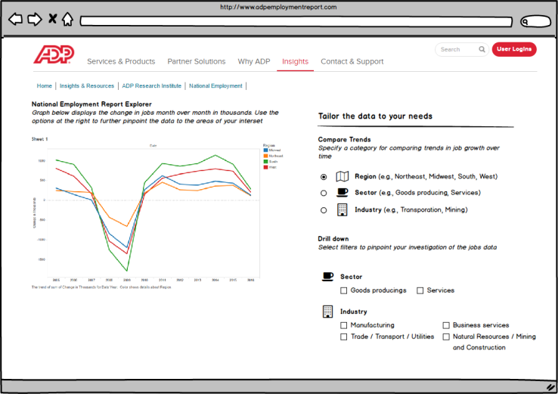
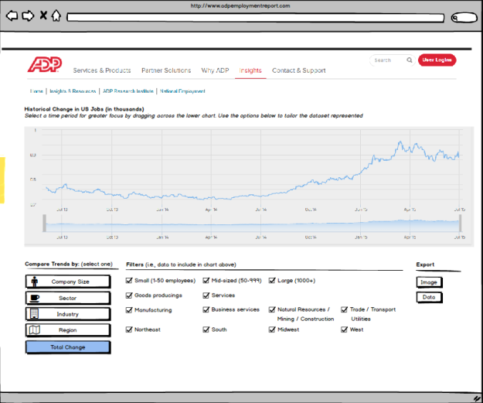
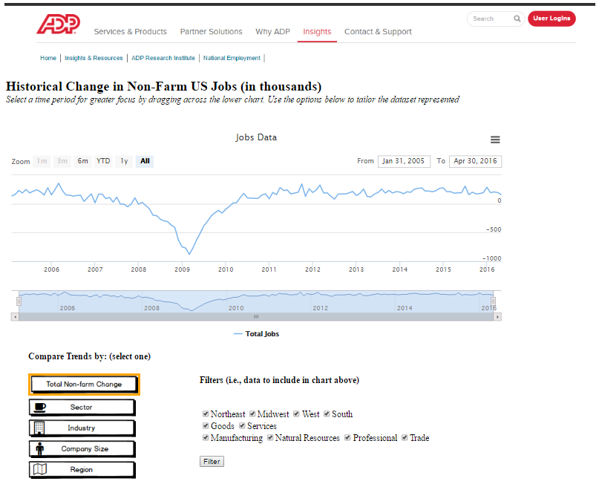
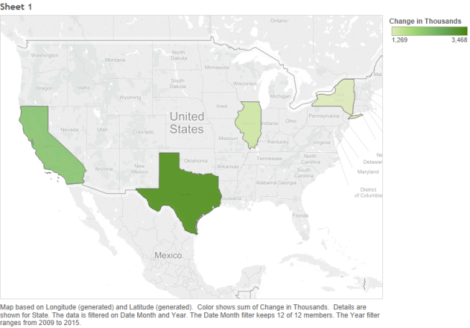
Based on user testing, we made multiple iterations on our visualizations (I) Jobs Explorer

Slide 13
Based on user testing, we made multiple iterations on our visualizations (II) BLS Comparison
RR

Slide 14

Our updated visualization http://spadela.pythonanywhere.com/
Visualization
ADD IN A SCREENSHOT;
We will Switch over to the demo at this point

Slide 15
APPENDIX

